Slide 1

Helping the US Government to run Kubernetes Everywhere..
17 February 2021
This is a title slide with an infinity image.

Slide 2
CAGE code: 8GLZ3
DUNS: 117387835
Rancher Government Solutions is specifically designed to address the unique security and operational needs of the US Government and military as it relates to application modernization, containers and Kubernetes.
Rancher is a complete open source software stack for teams adopting containers. It addresses the operational and security challenges of managing multiple Kubernetes clusters at scale, while providing DevOps teams with integrated tools for running containerized workloads.
RGS supports all Rancher products with US based citizens with the highest security clearances who are currently supporting programs across the Department of Defense, Intelligence Community and civilian agencies.
RGS is committed to helping the US Government run Kubernetes securely everywhere.
2
Notes:
2

Slide 3
Rancher Government Solutions Company Snapshot
Rancher Government Solutions is powering thousands of Federal customers’ mission-critical workloads, including electronic financial systems and enterprise applications, autonomous vehicles, satellite operation centers, life-saving medical devices, and missile systems
FAST FACTS
— 13 out of 15 largest FinServ firms
— 14 out of 15 largest aerospace firms
— 10 out of 10 largest automotive firms
— 13 out of 15 largest pharma firms
— 5 out of 5 largest technology firms
— 100% YoY growth
— 88% YoY growth for Rancher
— 50% ACV growth in cloud
— Member of CNCF board and TOC
— An independent leader in open source
3
Notes:
Fast Facts
We are proud to have:
13 out of 15 largest FinServ firms
14 out of 15 largest aerospace firms
10 out of 10 largest automotive firms
13 out of 15 largest pharma firms
5 out of 5 largest technology firms
all as customers of RGS.
In the first half of FY2021, SUSE saw 19% YoY growth as compared to the first half of FY2020.
Increased demand for containers
As the use of multi-cloud and cloud-native infrastructures grows, many companies are looking to containers, which allow for the abstraction of software applications so they can be run consistently regardless of operating system or infrastructure. SUSE Rancher is one of the most widely adopted container solutions and has experienced significant growth over the last year, with Annual Recurring Revenue growth of 91%.
Accelerating digitalization of modern enterprises leading to Cloud migration
Global trends in technology, workforces, economies and supply chains are driving the continued migration of on-premises workloads to the Cloud. This has contributed to particularly strong growth for SUSE in the Cloud route to market (RTM), which saw over 50% growth in Annual Contract Value, consistently across Q1 and Q2.
Initiatives, Associations, and Partnerships
SUSE has relationships with many leading technology providers including chip manufacturers like Intel, enterprise application providers like SAP, and hyperscalers like Microsoft. We also invest considerable time and resources in numerous industry initiatives and associations, including:
Cloud Native Computing Foundation (CNCF) serves as the vendor-neutral home for many of the fastest-growing open source projects, including Kubernetes, Prometheus, and Envoy.
The Open Container Initiative is an open governance structure for the express purpose of creating open industry standards around container formats and runtimes.
The Linux Foundation is a non-profit technology consortium founded in 2000 as a merger between Open Source Development Labs and the Free Standards Group to standardize Linux, support its growth, and promote its commercial adoption.
LF Networking software and projects provide platforms and building blocks for Network Infrastructure and Services across Service Providers, Cloud Providers, Enterprises, Vendors, and System Integrators that enable rapid interoperability, deployment, and adoption.
The Linux Foundation runs the Enabling Linux in Safety Applications (ELISA) open source project which was designed to create a shared set of tools and processes to help companies build and certify Linux-based safety-critical applications and systems whose failure could result in loss of human life, significant property damage or environmental damage. ELISA will make it easier for companies to build safety-critical systems such as robotic devices, medical devices, smart factories, transportation systems and autonomous driving using Linux.
O-RAN ALLIANCE is Transforming the Radio Access Networks Industry Towards Open, Intelligent, Virtualized and Fully Interoperable RAN. The O-RAN architecture is the foundation for building the virtualized RAN on open hardware and cloud, with embedded AI-powered radio control.
The 5G Automotive Association (5GAA) is a global, cross-industry organisation of companies from the automotive, technology, and telecommunications industries. Its goal is to develop end-to-end solutions for future mobility and transportation services, so avoiding incompatibility problems from the beginning.
GAIA-X is a project aim sis to develop common requirements for a European data infrastructure. Therefore openness, transparency and the ability to connect to other European countries are central to GAIA-X. Representatives from several European countries and further international partners are currently involved in the project.
The OpenPOWER Foundation is an open technical membership organization that promotes OpenPOWER – the most open
Open Mainframe Project is a Collaborative Project managed by the Linux Foundation to encourage the use of Linux-based operating systems and open source software on mainframe computers.
3

Slide 4
















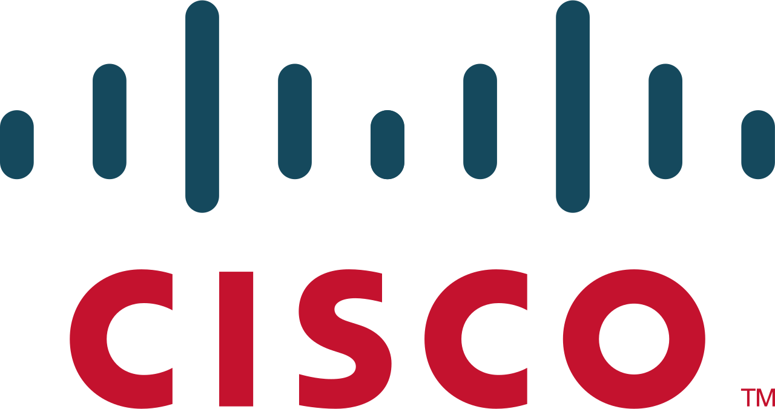
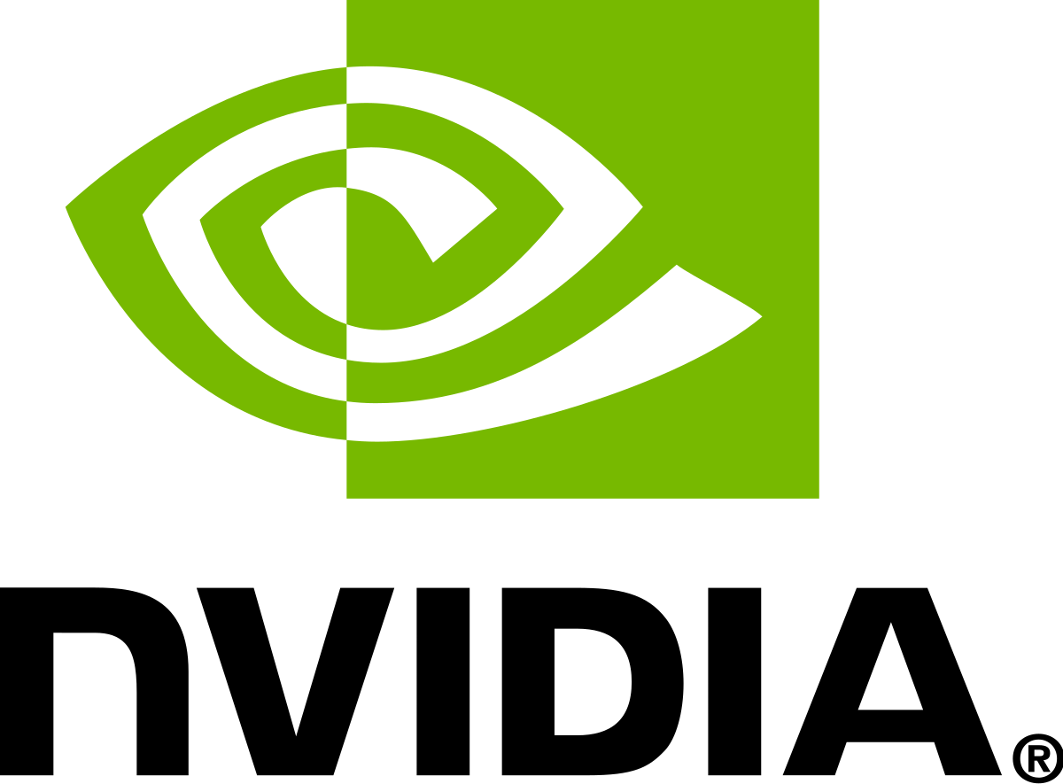


Rancher Government Solutions Company Snapshot
Rancher Government Solutions is powering thousands of Federal customers’ mission-critical workloads, including electronic financial systems and enterprise applications, autonomous vehicles, satellite operation centers, life-saving medical devices, and missile systems
INDUSTRY INITIATIVES & ASSOCIATIONS
PARTNERSHIPS
4
Notes:
Fast Facts
We are proud to have:
13 out of 15 largest FinServ firms
14 out of 15 largest aerospace firms
10 out of 10 largest automotive firms
13 out of 15 largest pharma firms
5 out of 5 largest technology firms
all as customers of SUSE.
In the first half of FY2021, SUSE saw 19% YoY growth as compared to the first half of FY2020.
Increased demand for containers
As the use of multi-cloud and cloud-native infrastructures grows, many companies are looking to containers, which allow for the abstraction of software applications so they can be run consistently regardless of operating system or infrastructure. SUSE Rancher is one of the most widely adopted container solutions and has experienced significant growth over the last year, with Annual Recurring Revenue growth of 91%.
Accelerating digitalization of modern enterprises leading to Cloud migration
Global trends in technology, workforces, economies and supply chains are driving the continued migration of on-premises workloads to the Cloud. This has contributed to particularly strong growth for SUSE in the Cloud route to market (RTM), which saw over 50% growth in Annual Contract Value, consistently across Q1 and Q2.
Initiatives, Associations, and Partnerships
SUSE has relationships with many leading technology providers including chip manufacturers like Intel, enterprise application providers like SAP, and hyperscalers like Microsoft. We also invest considerable time and resources in numerous industry initiatives and associations, including:
Cloud Native Computing Foundation (CNCF) serves as the vendor-neutral home for many of the fastest-growing open source projects, including Kubernetes, Prometheus, and Envoy.
The Open Container Initiative is an open governance structure for the express purpose of creating open industry standards around container formats and runtimes.
The Linux Foundation is a non-profit technology consortium founded in 2000 as a merger between Open Source Development Labs and the Free Standards Group to standardize Linux, support its growth, and promote its commercial adoption.
LF Networking software and projects provide platforms and building blocks for Network Infrastructure and Services across Service Providers, Cloud Providers, Enterprises, Vendors, and System Integrators that enable rapid interoperability, deployment, and adoption.
The Linux Foundation runs the Enabling Linux in Safety Applications (ELISA) open source project which was designed to create a shared set of tools and processes to help companies build and certify Linux-based safety-critical applications and systems whose failure could result in loss of human life, significant property damage or environmental damage. ELISA will make it easier for companies to build safety-critical systems such as robotic devices, medical devices, smart factories, transportation systems and autonomous driving using Linux.
O-RAN ALLIANCE is Transforming the Radio Access Networks Industry Towards Open, Intelligent, Virtualized and Fully Interoperable RAN. The O-RAN architecture is the foundation for building the virtualized RAN on open hardware and cloud, with embedded AI-powered radio control.
The 5G Automotive Association (5GAA) is a global, cross-industry organisation of companies from the automotive, technology, and telecommunications industries. Its goal is to develop end-to-end solutions for future mobility and transportation services, so avoiding incompatibility problems from the beginning.
GAIA-X is a project aim sis to develop common requirements for a European data infrastructure. Therefore openness, transparency and the ability to connect to other European countries are central to GAIA-X. Representatives from several European countries and further international partners are currently involved in the project.
The OpenPOWER Foundation is an open technical membership organization that promotes OpenPOWER – the most open
Open Mainframe Project is a Collaborative Project managed by the Linux Foundation to encourage the use of Linux-based operating systems and open source software on mainframe computers.
4

Slide 5

Rancher Government Solutions
Engineering Cloud Native Computing Platforms for the US Government
Rancher Federal is a 100% US-based entity dedicated to delivering Kubernetes and Cloud Native Technology solutions and support across the DoD, IC, and Federal community
Rancher Federal offers varying levels of service including US-State Side Support and cleared on-site support
Rancher Federal exists to enhance Rancher’s capabilities to meet the ever-evolving Federal mission requirements
PKI Authentication
SELinux/FIPS Compliance
STIG/CIS Hardening
Enterprise Audit Functionality
Air-Gapped, C2S, SC2S, GovCloud Support
Automated Upstream Image Vulnerability Scanning
Notes:
5

Slide 6



Rancher’s Three Pillars of Success
Go to Market and Accelerate Mission
V
Enterprise Support
Professional Services
Mission - Accelerator
24/7 CONUS-based enterprise support for Rancher & Kubernetes ecosystem.
Technical Account Manager & bootstrap architecture support
Cleared Onsite support (70% of RFed engineers have at least a TS/SCI)
On-Prem/Airgap as a first-class citizen
Training
On-site (or remote) full-time engineers
Cloud-native advocates & evangelists focused on bootstrapping or delivering customer success
Multiple prime contracts at USAF PlatformOne
Dedicated to weaponizing the Rancher product portfolio to work better in air-gap/classified/mission environments
Bring a security-first mindset to the Rancher capabilities by baking in NIST FIPS-140-2/3 encryption & DISA STIG certification
Collaborated to develop the RKE Government/RKE2 secure-by-default Kubernetes distribution
Notes:
6

Slide 7










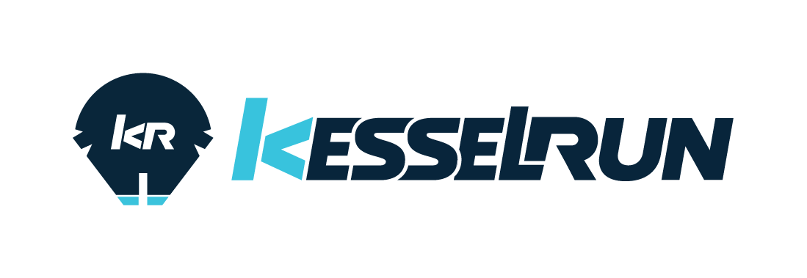
Active Authorities to Operate (ATOs)
Accelerating Federal stakeholders to empower the mission from development to production

Slide 8

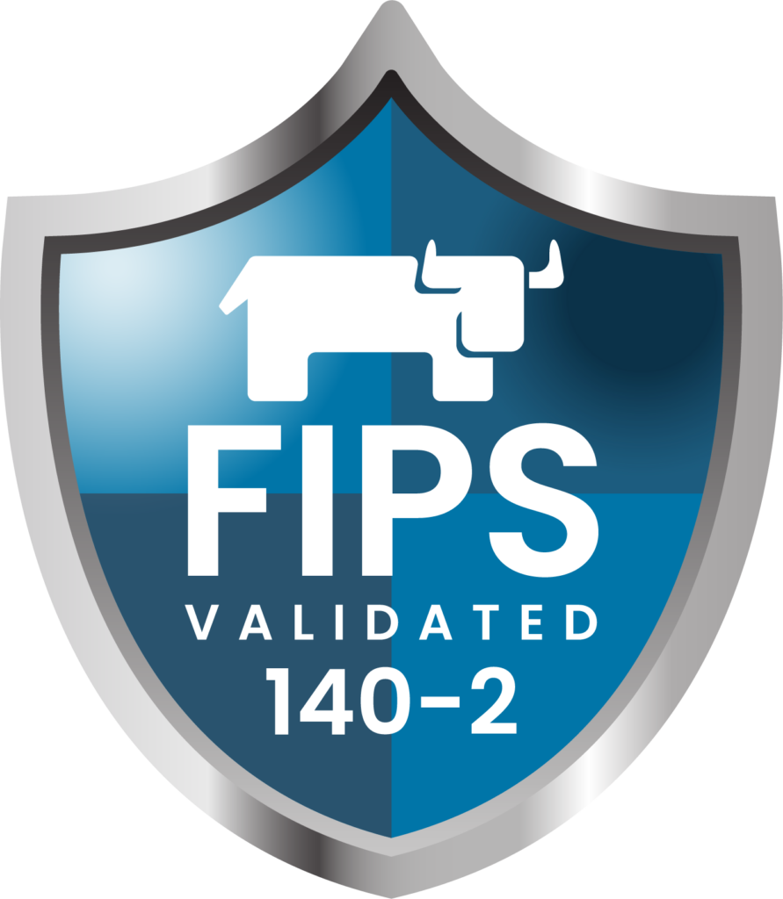

Rancher Government Solutions: Security First
Enabling security at every layer for our federal partners
DISA STIGs currently in certification:
Rancher MCM 2.5 (completed, waiting for public release)
RKE2 (based on draft k8s STIG)
RKE2 FIPS-140-2 support- The only vendor supporting FIPS in FOSS
Labs engineers contributed patches to containerd docker-runtime to enable SELINUX for k3s and RKE2 distributions
CIS-benchmark tool enables automated security scans and validation
We provide a STIG’d AMI-builder allowing customers to generate hardened OS images built for RKE2
RFed built WYATTEARP, a code-scanning pipeline that generates vulnerability reports of each Rancher Labs docker images and provides them to our customers.
Currently ATO’d across the DoD/IC on multiple classification domains
RKE2 is the only distribution of FIPS-140-2 Kubernetes certified and hosted in the USAF IRONBANK container registry

Slide 9



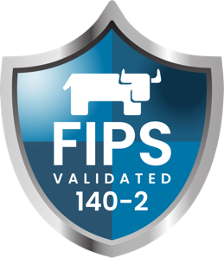
Rancher Government Solutions Security and Compliance
DoD and IC cleared federal contractor (pending)
Conducting business across the DoD, IC and Federal Space
DISA STIG certified
Rancher MCM 2.5
RKE2 Kubernetes Distribution (based on draft k8s STIG)
RKE2 FIPS-140-2-3
The only vendor supporting FIPS in FOSS
PlatformOne-DevSecOps Continuous ATO initiative
RKE2 is the only Kubernetes Platform hosted in the USAF IRONBANK container registry.
CIS- benchmark tool
Enables automated security scans and validation
STIG’d AMI
Builder allowing customers to generate hardened OS imagesbuilt for RKE2
Iron Bank Compliance Link: https://repo1.dso.mil/platform-one/distros/rancher-federal/compliance-artifacts/compliance-matrix

Slide 10
Public Use Cases
Bleeding-edge technology advancing the mission landscape tomorrow
CDC: Operation WARPSPEED
USAF: Platform-One
U2: Federal Laboratory
Platform Engineering Support contract focused on a ‘Get Well Strategy’ to modernize the CDC’s immunization data lake infrastructure
Consulting engineers introduced a hybrid-cloud architecture that migrated CDC workloads from pure AWS -> AWS, Azure, on-prem
2 Prime contracts with USAF P1 with 18 FTEs supporting the DevSecOps initiatives and platform infrastructure.
70% of P1 Kubernetes clusters are running Rancher’s RKE2 distribution
Rancher’s k3s distro is shipping on a USAF Edge-One satellite mission in CY2021.
Direct Support: ABMS, F35, INSCOM
C-ATO Approval
The U2 Spy Plane has been retrofitted with computational hardware running Rancher’s K3s distribution for cloud-native AI/ML in-flight
Rancher Federal engineers executed a ‘get-well’ strategy enabling the U2 Fed-lab to modernize a 60-plane into a foundational platform for a modern-day mission weapons platform
10
Notes:
10

Slide 11
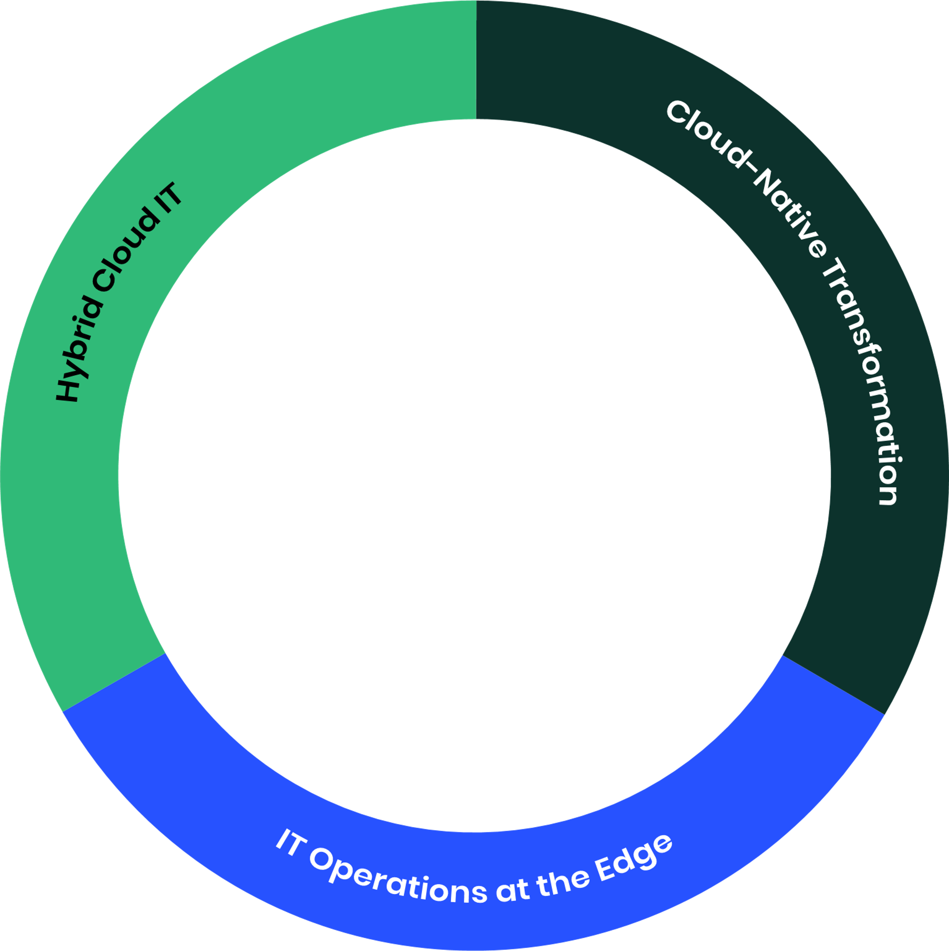
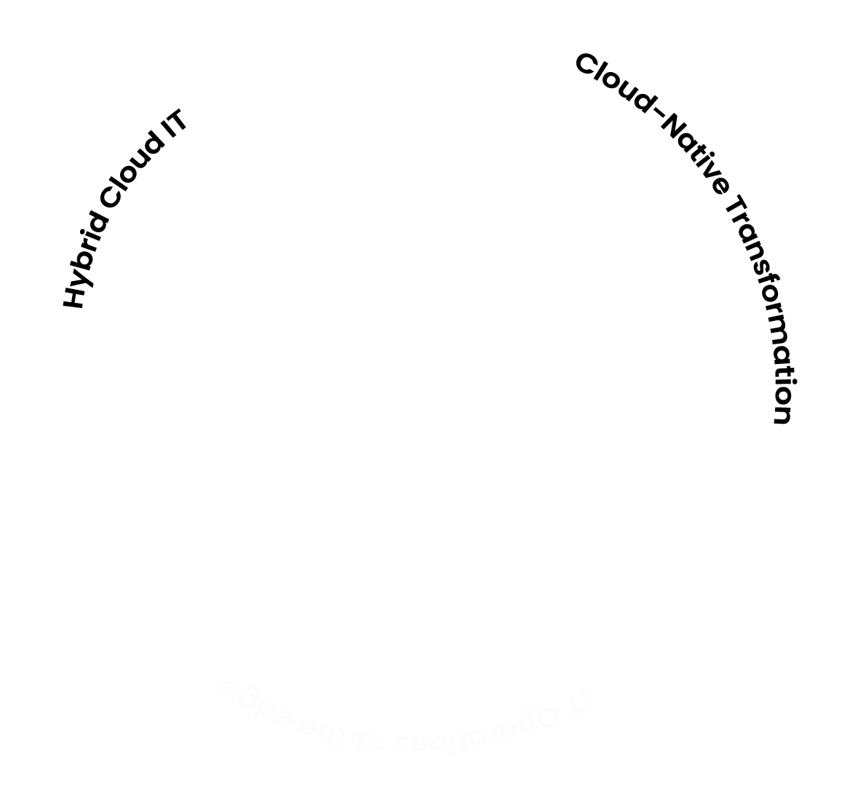
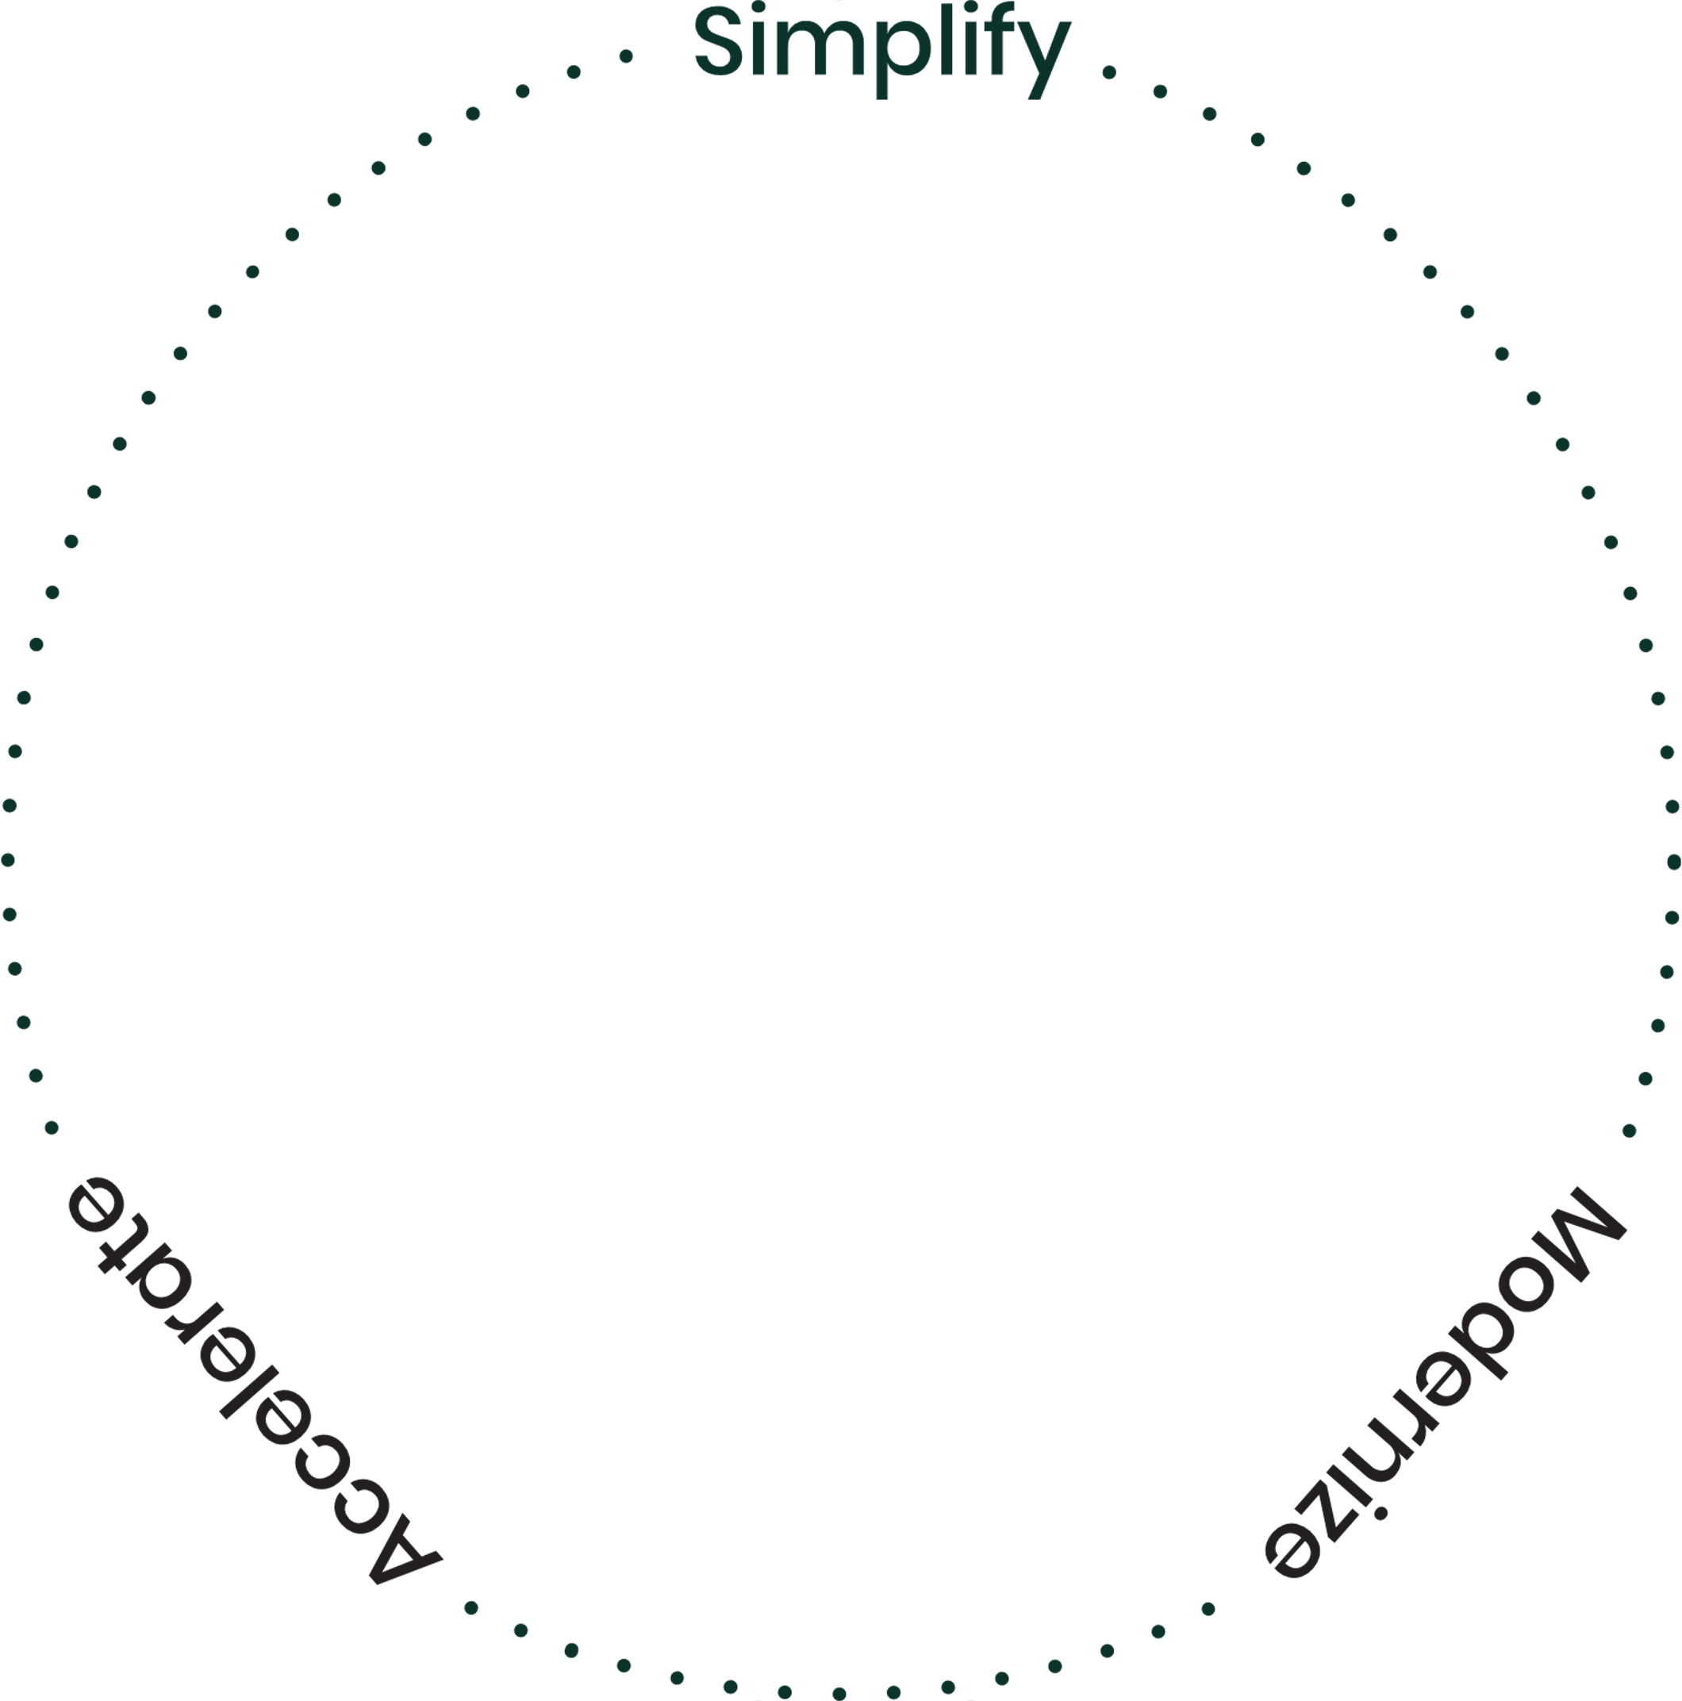
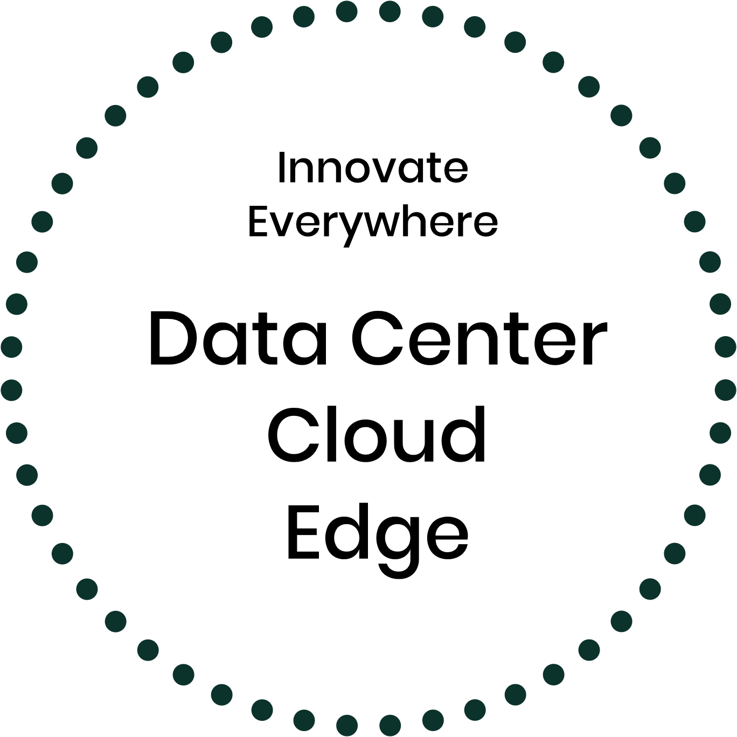
Supporting RGS Customers To Transform
Simplify and optimize existing environments
Bring apps and infrastructure into modern cloud computing
Complexity of managing hybrid cloud infrastructure and apps
Run workloads anywhere, containers, VMs, on-premises and across clouds
Container and Kubernetes complexity
Modernizing legacy apps and accelerating time to market
Secure operation of all mission-critical workloads
Need to eliminate
downtime
Reduce cost and risk
Accelerate business innovation
Lack of a consistent platform from core, to cloud, to edge
Concerns about security, privacy, compliance
Breadth and complexity of edge use-cases
Notes:
First, it’s important to understand the current market dynamics.
Today, businesses have to offer their goods and services in very different ways than in the past, and the global pandemic has only accelerated that shift.
Businesses need to integrate digital technology, software and infrastructure, into everything they are doing. It is resulting in fundamental changes to business culture, operational processes and value delivery to customers.
To respond quickly, businesses need to take an agile approach to IT, to software development and delivery.
Concretely speaking, our customers need software applications in multiple environments, running more and more of them as a service while keeping core applications on premise for compliance or security reasons for instance.
They are moving some of the legacy applications to the cloud to gain agility and reduce cost, and in parallel, as increases in compute power and network speeds converge, applications and data move also to the edge to improve performance and transact business faster.
It comes with opportunities and challenges. For instance, workloads, including mission critical ones, have to be able to run reliably anywhere, on-premises and across clouds, as containers or within virtual machines.
Application modernization and migration to the cloud are also required, together with the need to consistently manage hybrid cloud infrastructure, including at the edge that come with fragmentation, security and scale challenges.
To help our customers achieving all of that, at SUSE we are supporting them to freely innovate everywhere.
And we are uniquely positioned to do so, as two core technologies required for this to happen are containers and Linux. And we are a leader in both!
11

Slide 12






Powering Innovation With Leadership in Linux & Kubernetes
Catalog
Rancher
Storage
Security
The platform for managing all Kubernetes distributions
Governance
Support & Services
2
Datacenter
Edge
Block Storage
ubuntu
Oracle Linux
Red Hat
Linux
Hybrid
Cloud
Infrastructure
Dev
Datacenter
Cloud
Agency
Edge
Red Hat
Notes:
At the heart of our strategy is our leadership in the two most important technologies powering digital transformation; Linux and Kubernetes:
When it comes to running all your workloads, one size Linux OS does not fit all. That’s why we offer the industry’s most adaptable Linux operating system. No matter what your workload requirements (performance, reliability, operating environment), we have an operating system solution purpose-built for your needs. And, if you are running OS’s from other vendors, no problem, SUSE Manager provides a single platform for managing all of your Linux operating systems on-premises or in the cloud.
The same holds true for Kubernetes. SUSE offers the industry’s only container management platform provide full management of all Kubernetes distributions. Whether managing one cluster or one million clusters, our SUSE Rancher provides a simple, consistent management experience no matter what Kubernetes distributions you are using, from SUSE or other vendors, and no matter where they are running – on-premises, in the cloud, or on the edge.
Together, our industry leading Linux OS and Kubernetes management technologies give you the power to address today’s business challenges and the flexibility to adapt your strategy to address tomorrow’s challenges as they evolve.
12

Slide 13
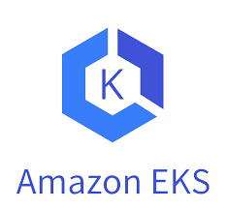



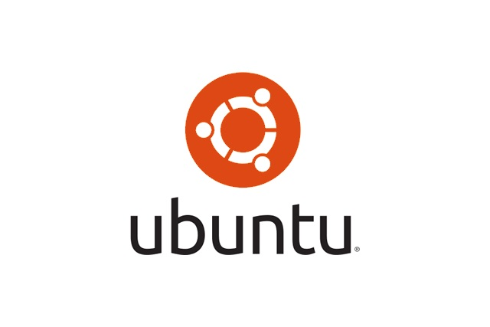





Rancher’s Open, Interoperable Approach
Datacenter
Edge
Block Storage
Rancher
Other Kubernetes Distros
2
Azure AKS
Google GKE
Linux Distros
Hybrid Cloud Infrastructure
RGS Linux Enterprise
SUSE Linux Enterprise Server
Notes:
Not only is SUSE a leader in the two most important technologies powering digital transformation; Linux and Kubernetes, but unlike our competitors who focus on locking you into their proprietary technology stack, our open interoperable approach puts all the control in your hands to choose the best technology, whether SUSE or not, to meet your needs.
For Linux, that means you can use and manage any Linux distribution across the SUSE Linux family or from other Linux vendors.
For Kubernetes, it means you get a consistent and complete management experience for any Kubernetes distro, running on any Linux distro, across any environment from data center to cloud to the Edge.
SUSE’s goal is not to lock you in, but to help you create the optimal solutions to address your business challenges.
13

Slide 14



Open, Interoperable Solution Bundles
Hybrid IT
Edge
Rancher
Rancher
Cloud-native
SUSE Manager
SUSE Manager
Cloud-ready
SUSE Linux Enterprise Server
SUSE Linux Enterprise Micro
14
Notes:
Note to Presenter: These solutions will be available in June 2021.
Our open interoperable approach means you can run any Kubernetes distros on SUSE Linux, and you can run Rancher Kubernetes on any Linux distro. But we also believe you can benefit even more when you adopt both SUSE Linux and SUSE Rancher products. For that reason, we offer two open, interoperable solutions:
The SUSE Hybrid IT solution consists of SUSE Rancher, RKE, Longhorn, SUSE Manager, and SLES, offering the complete software stack needed to run both traditional applications and cloud native applications in datacenter and cloud.
The SUSE Edge solution consists of SUSE Rancher, K3s, Longhorn, SUSE Manager, and SLE Micro. SUSE Edge solution offers the complete software stack needed to deploy applications on a very large number of Linux nodes and Kubernetes clusters.
Our open interoperable solutions offer many advantages over deploying standalone Linux and Kubernetes. You not only get discounted bundle pricing, you also enjoy an integrated and easy to manage experience. Equally important, our solutions allow you to plug in products from other vendors and create a multi-vendor technology stack. As much as we want to offer complete solutions, we take pride in our openness. We win you over by delivering the best technology and will never create artificial barriers to lock you in.
Close
I really appreciate the time you have given us to learn more about SUSE. I would be happy to delve into any particular topics and/or answer any questions you may have.
14

Slide 15



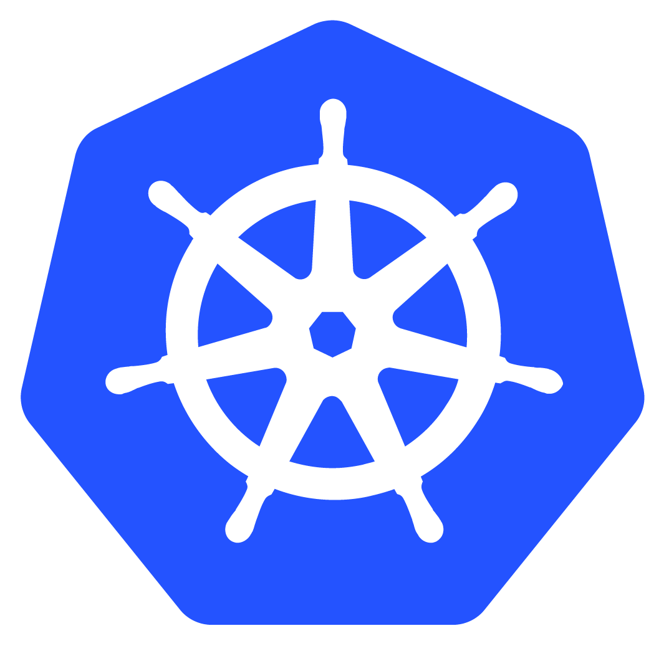
Rancher’s Unique Approach
It's a multi- cluster world
Treat all Kubernetes distributions as first class citizens
Value is in Kubernetes management
‘Open’ approach to open source
Notes:
It’s a multi-cluster world
SUSE Rancher has been a pioneered multi-cluster management for more than four years. With the release of OpenShift ACM and Tanzu, we’re seeing the competition trying to catch-up.
Kubernetes distributions are commoditized
Increasing customers are realizing that the business value of Kubernetes isn’t in the distribution itself. There are many Kubernetes distributions tailored for different use cases including the popular cloud hosted distributions - Amazon EKS, Microsoft AKS, Google GKE. SUSE Rancher has 3 distributions now – RKE (datacenter/hybrid cloud), RKE Government (FIPS-enabled), K3s (lightweight distro for edge and embedded). They argument that one vendors distribution is superior to others doesn’t hold anymore.
Value is in Kubernetes management
SUSE Rancher unites Kubernetes clusters with centralized authentication and access control, enterprise security, auditing, backups, upgrades, observability and alerts. Deploy and secure clusters consistently in minutes anywhere using our intuitive UI or powerful CLI.
Manage on-prem clusters and those hosted on cloud services like AKS, EKS & GKE from a single pane of glass. Centrally configure security policy, audit logs and monitor performance. Deploy multi-cluster apps consistently from our app catalog. Control access by connecting them to your internal identity provider like Active Directory, LDAP or Okta.
SUSE Rancher supports tools that DevOps teams already love like Jenkins, Gitlab or Travis for building CI/CD pipelines, Prometheus and Grafana for observability, Fluentd for logging, and Istio for service mesh.
SUSE Rancher allows direct enablement of the encryption provider, and configuration of audit logging and rate-limiting. Scan and assess cluster configurations against CIS benchmark best practices. Consistently deploy securely provisioned clusters using cluster templates across multiple substrates. Includes support for air-gapped environments.
‘Open’ approach to open source
SUSE Rancher supports any CNCF-certified Kubernetes distribution, any enterprise-grade operating system (including RHEL, SLES, Ubuntu, Centos and Windows), and x86+Arm architectures. We believe that customers should chose which technology stack is optimal for their use case.
15

Slide 16
Rancher’s Unique Approach to the
Kubernetes is the computing standard
Innovations that push the market forward
Developer experience driven
100% Open Source
Don’t hold any features back
Drives massive adoption
Enterprise subscription plan
Embrace cloud Kubernetes services (EKS/AKS/AKS)
Edge computing with K3s
Multi-cluster management with Rancher
K3s
Rio
Longhorn
Submariner
UX-centric development
No docs install
Zero consulting implementation
Freedom to choose the tools and frameworks

Slide 17











Putting it all together
ITOps Provisions Kubernetes, Maintains Central Control & Visibility
Resources Leverage Kubernetes Shared Services
DevOps Realizes Advanced Capabilities
With Kubernetes
Cluster-as-a-Service
Ecosystem Catalog
Continuous Delivery
Namespace-as-a-Service
Canary, Blue/Green Deployments
Scope Capacity
Delegate Administration
Apply Access and Security Policies
Reactive Autoscaling
App Packaging
Automate DNS & Load Balancing
Logging
SSL and Certificate Management
Monitoring & Alerting
Secret Management
Service Mesh
17
Notes:
17

Slide 18

















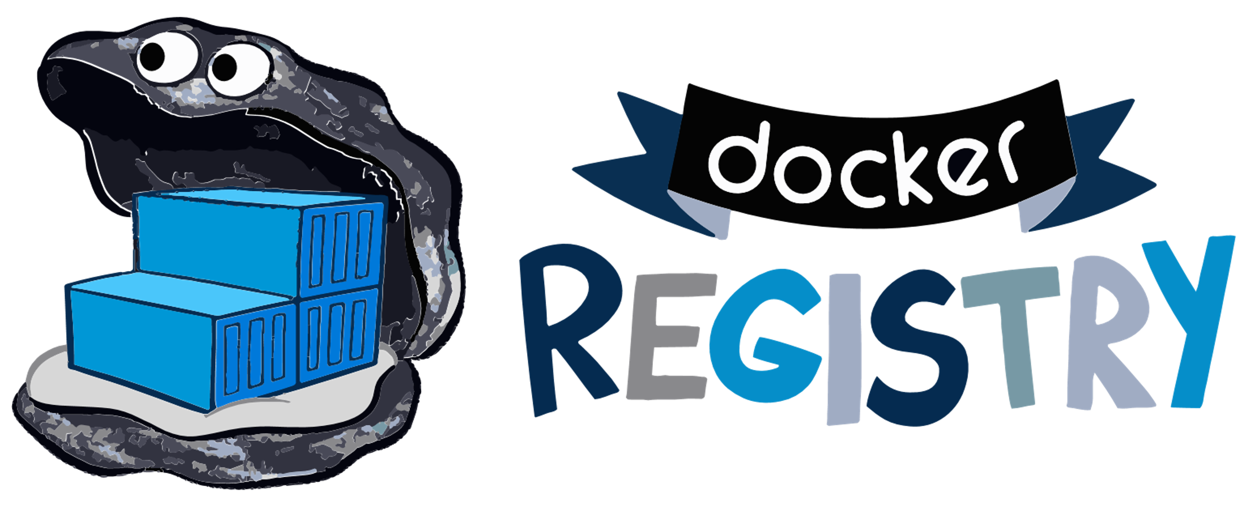





















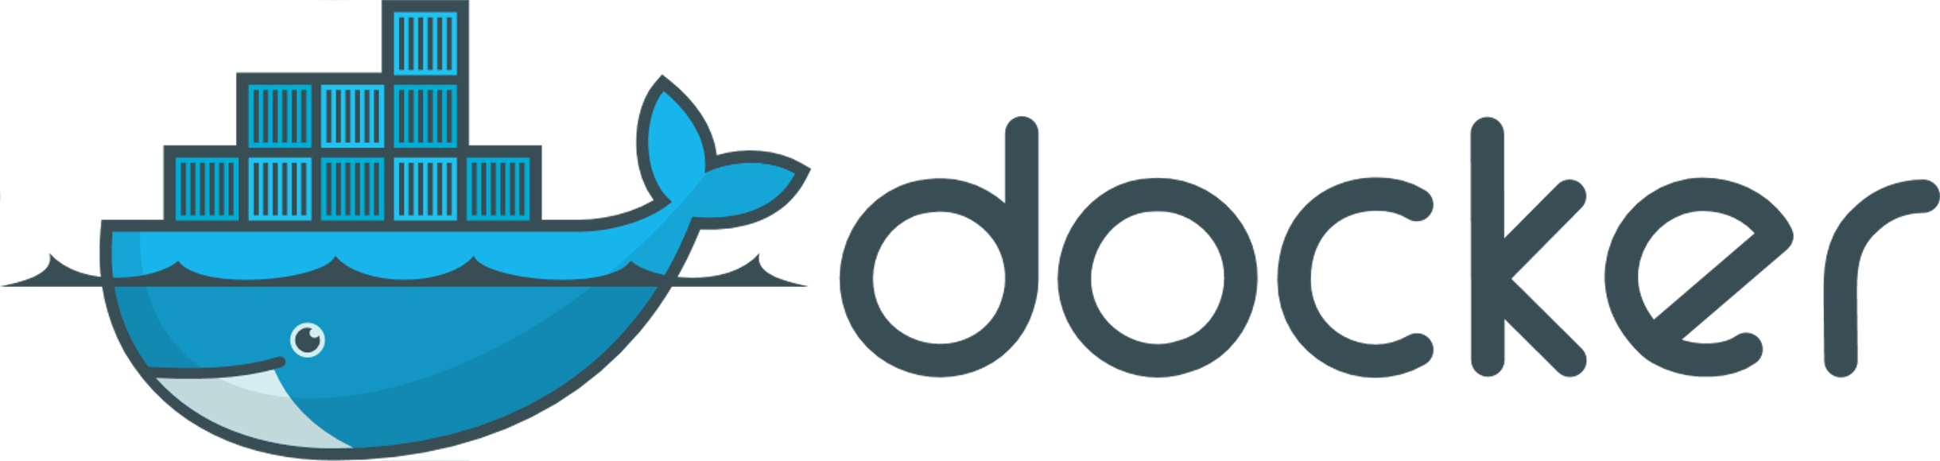







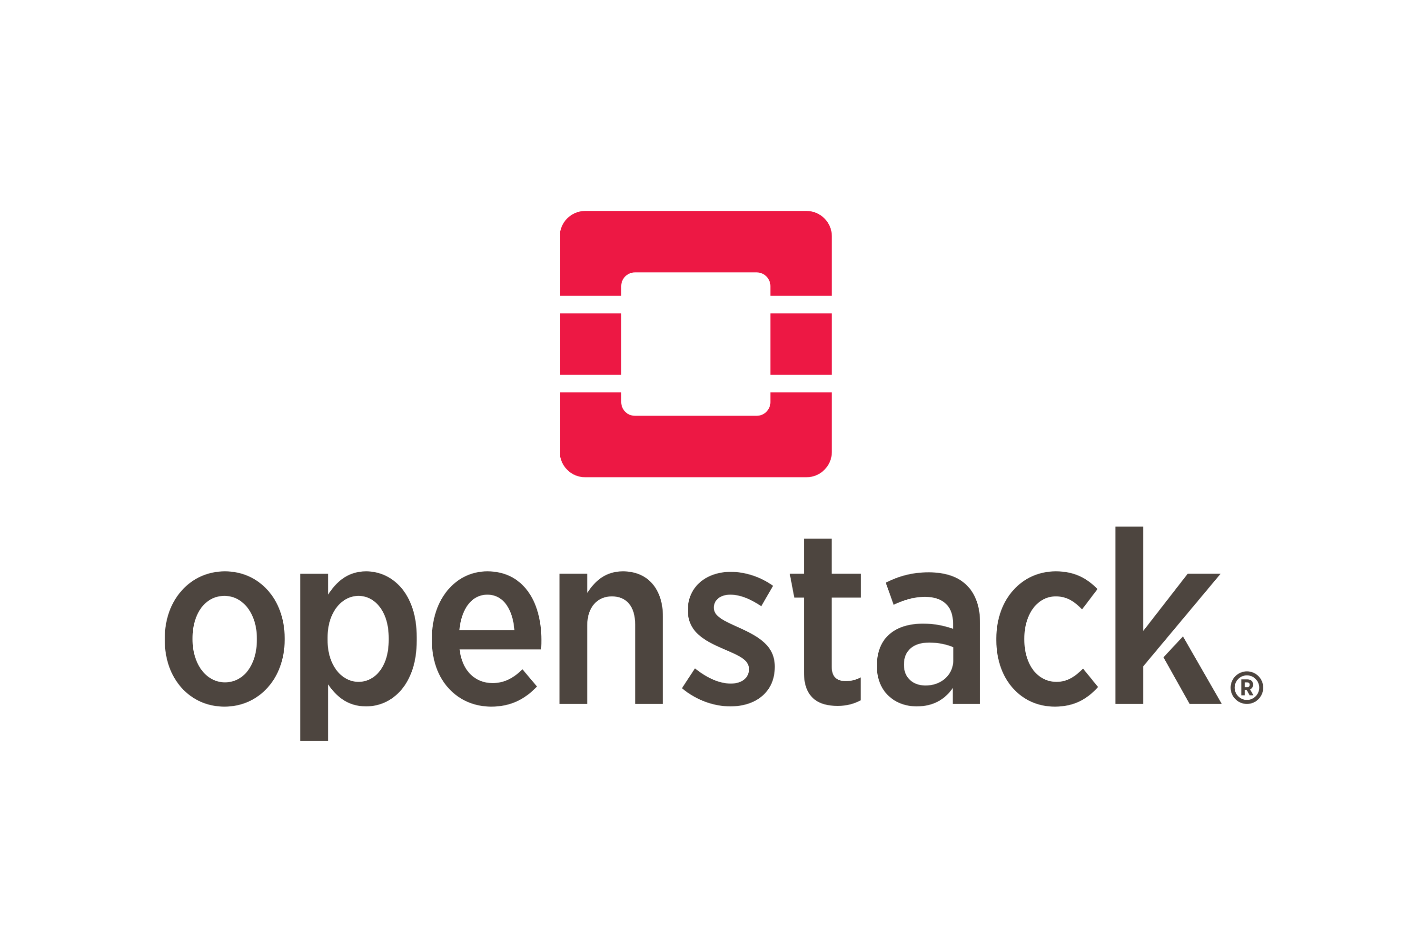
Rancher Integrations
Rancher SLA
Certified Integrations
Authentication & Authorization
App Management & CI/CD
Monitoring & Logging
Registry & Image Scanning
Container Security & Secrets
Networking & Service Mesh
Platforms & Orchestration
GKE
AKS
Persistent Storage
Container Engine
Operating Systems
Infrastructure Drivers
18
Notes:
18

Slide 19
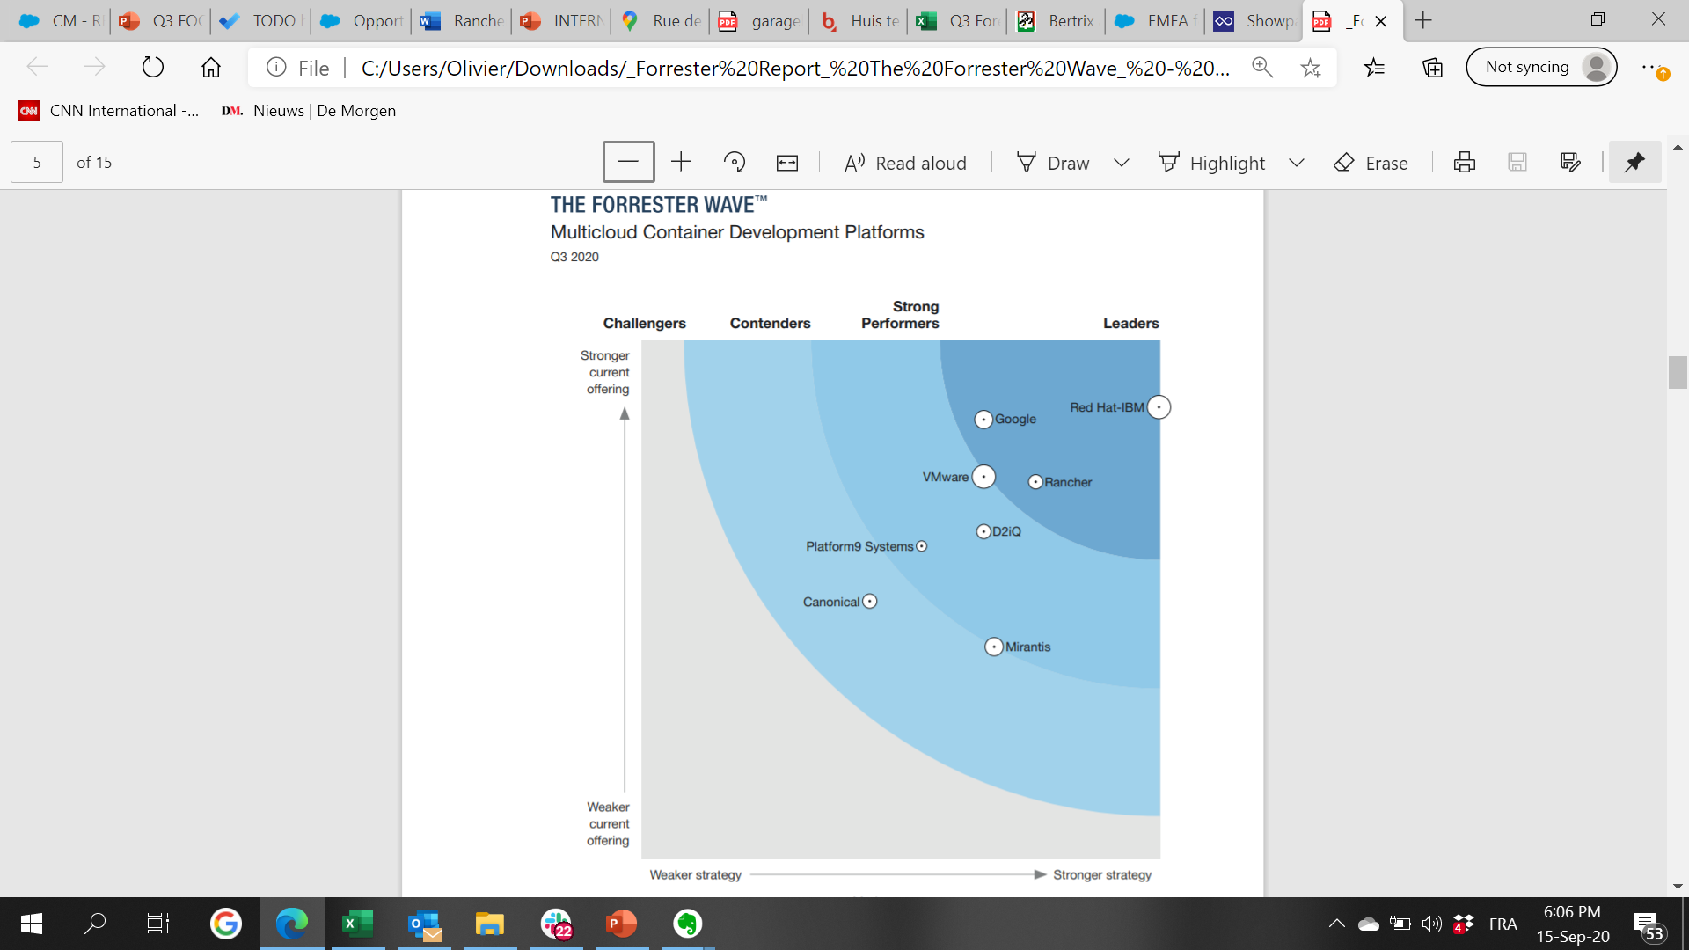
We are a Leader in Kubernetes Management
19
Notes:
.
19

Slide 20
Comparing Kubernetes Approaches
Legacy
Potential Pitfalls
OpenShift Container Platform
Are you compromising your agility with legacy technology?
Do you want to continue to be locked into monolithic stacks?
Are you limiting your multi-cloud, networking and storage options?
Are you paying for software that you don’t need?
Do you want to trust legacy vendors with your cloud native transformation?
OpenShift Kubernetes Distro
Red Hat Enterprise Linux
Tanzu Mission Control
Cloud Foundation Services
vSphere
Notes:
Our two key competitors in the Kubernetes Management space are – biased closed architecture
**MOSA- modules open systems architecture**
IBM / RedHat OpenShift
And Vmware Tanzu
Both great software companies but their offerings have a number of challenges:
Their legacy technology can compromise your agency
Red Hat’s and VMware seek to push their entire monolithic stacks on customers to cut out both traditional and cloud-native storage & network vendors, limit your ability to leverage multiple clouds
Their pricing models are designed to make you pay for features that you don’t need ensure to demonstrate false value
When locaked into their technology stacks and commercial terms, do you want to trust legacy vendors with your cloud native transformation?
20

Slide 21


Products
This is a subheading if you wish to add further detail to the slide. Ignore if you don’t.

Slide 22









Products and Projects
RANCHER
Flagship product – Rancher Multi-cluster Manager is world’s most popular Kubernetes Management platform
A CNCF-certified Kubernetes distribution that built to the security requirements of the DoD/IC
A CNCF-certified, Lightweight Kubernetes distribution. Easy to install, half the memory, all in a binary less than 100MB
COMMERCIALLY SUPPORTED PRODUCTS
HARVESTER
Highly availablepersistent block storage for microservices-based, stateful applications
Kubevirt-powered Hyperconverged Infrastructure (HCI) for deploying traditional VMs on Kubernetes Coming Soon
GitOps & Continuous Delivery at scale. Deploy & manage thousands to millions of clusters at the network edge
OPEN SOURCE PROJECTS
Built to connect overlay networks of different Kubernetes clusters
22
Notes:
22

Slide 23





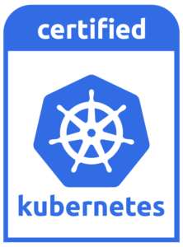
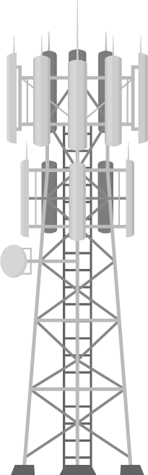


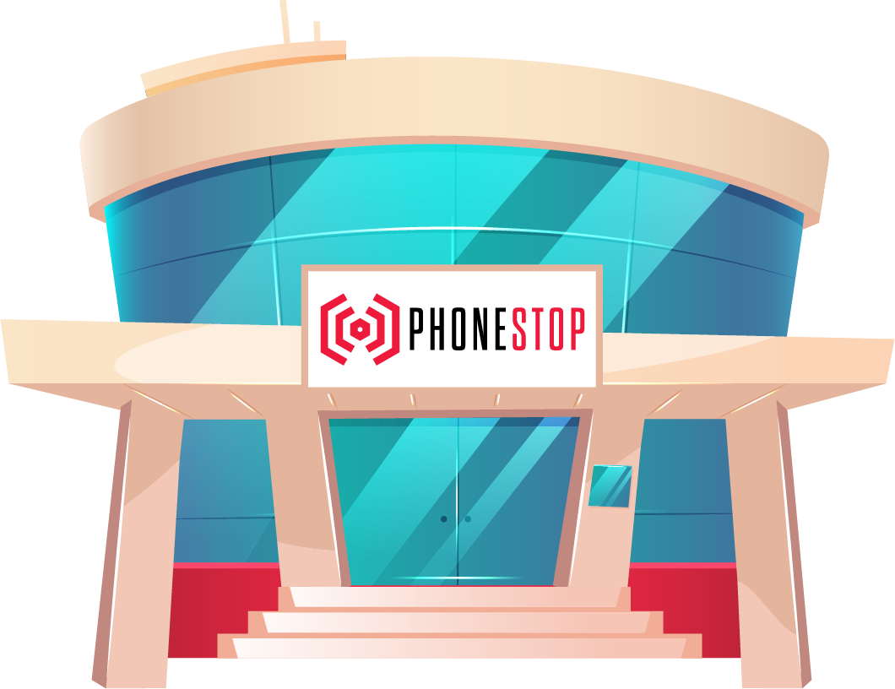

Rancher: Meeting You At Your Mission
Containerized App 1
Containerized App 2
Containerized App 3
Platform Services (Build & Run)
Rancher Catalog
Monitoring & Alerts
Dashboards & Observability
Service Mesh
Terraform Operator
Longhorn Storage
Security & Authentication
Policy Enforcement & Governance
Centralized Audit
Monitoring & Logging
CIS Benchmarking
RBAC, OPA, Pod & Network Policies
Simplified Cluster Operations & Infrastructure Management (Run & Manage)
Kubernetes version management
Dashboard, Monitoring & Diagnostics
Advanced Infrastructure Monitoring & Alerting
Cluster Templates & Config Enforcement
Node Pool Management
Cluster Provisioning & Lifecycle Management
Amazon
EKS
Azure
AKS
Google
GKE
Datacenter
Cloud
Dev
Branch
Edge
Notes:
Talking Points
There are two key pillar of a successful Kubernetes strategy:
Pillar #1 - Certified Kubernetes Distributions – to enable compute everywhere, you need to deploy certified Kubernetes distributions everywhere you need compute – in the datacenter, in the cloud, across desktop, branch, and edge locations
Pillar #2 - Centralized Management – you need to deploy a centralized management control plane, that delivers three key capabilities:
Consistent cluster operations – enabling ITOps teams to manage all of your certified Kubernetes distribution with a consistent interface, regardless of who developed the distribution or where it runs
Security, Policy, and User Management – enabling ITOps teams to automate processes and applying a consistent set of user access and security policies for all of your clusters no matter where they are running.
Shared Tools & Services – any Kubernetes management platform need to provide seamless access to DevOps tools and services including app packaging, CI/CD, logging, monitoring, and service mesh
23

Slide 24
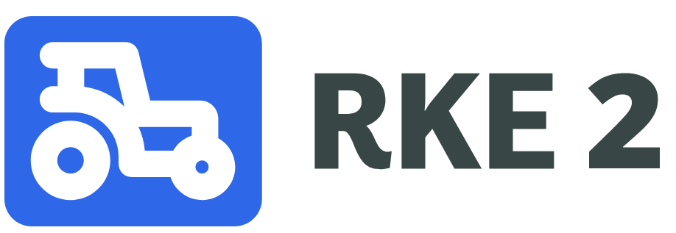

Security focused next-generation Kubernetes distribution
Features:
The only FOSS FIPS-140-2-validated* certified k8s distro
containerd/Docker/CRI-O** Runtime Support
UBI7 Base Image
SELINUX support contributed back to upstream containerd
Static-compiled binary w/ airgap-support. Validated and tested in GovCloud, SC2s, C2s
Self-installing manifest support
Terraform, Ansible modules available
Why?
Addresses security needs of US government customers need for compliance-based approach towards security
https://rke2.io
Notes:
24

Slide 25
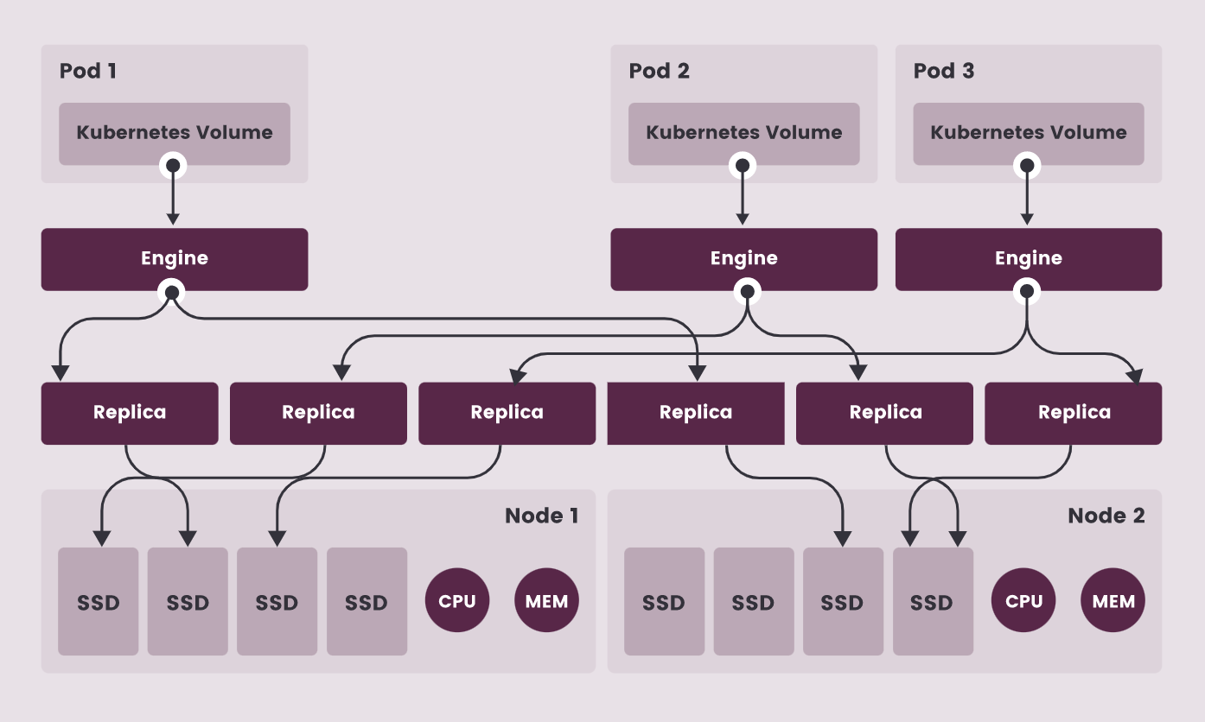

What is Longhorn?
v
Highly available, software-defined persistent block storage for Kubernetes.
Lightweight, reliable, and easy-to-use.
DevOps can deploy Longhorn from Rancher with just one-click.
Adds persistent volume support to any certified K8s cluster.
Storage Agnostic – any ext4 filesystem can be added to a Longhorn cluster
NFS and S3 compatible (backup storage)
Kubernetes-first design –implemented in CRDs and controller pattern
Open source and owned by the CNCF
Notes:
Longhorn is a solution for distributed, replicated storage inside of a Kubernetes Cluster that uses containers as storage replicas.
Simplicity and ease of use is key: Principle of least surprise. Analog to what the creator of the Ruby programming language Yukihiro Matsumoto
Says: “Ruby is designed for humans, not machines"
It will run multiple replicas on different nodes making sure that data is synchronized between them and then it presents a single volume to Kubernetes to attach to a workload.
Longhorn v1.0 GA is a reliable, stable, easy to use and performant general-purpose container attached storage solution that will fit the majority of uses cases.
25

Slide 26
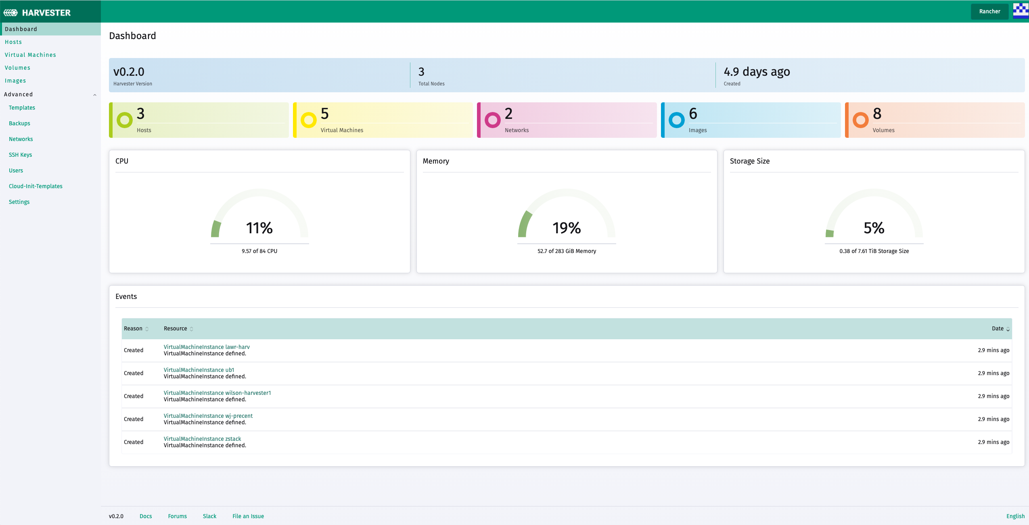



What is Harvester?
Enterprise-grade FOSS Hyperconverged Infrastructure Provider & VM Management
Layer 1 Hypervisor capable of deploying traditional Virtual Machines as well as elastic Kubernetes clusters
Integrates storage, networking, and virtualization (hyperconverged) into a single stack
Commoditizes the ‘cloud experience’ on your own bare-metal machines, perfect for air-gap or edge where C2s/SC2s is not available
GA Fall 2021
RANCHER
Kubernetes
HARVESTER
K8s VMs
K8s VMs
Harvester
Harvester
Harvester
Server
Server
Server
Notes:
26

Slide 27

Harvester 10k View
HARVESTER
Decouple Hardware and Software
An Open Approach
Leverage open source for your HCI layer instead of the proprietary platforms of the past.
HCI solutions tied to hardware become brittle over time.
Simplify HCI
Converge Kubernetes
Make bare-metal infrastructure as easy as the cloud
Harvester integrates with Rancher to provide the best-in-class Kubernetes experience
Accelerate Application Delivery
Deploy Anywhere
Datacenter, campus IT, and edge
Harvester makes it easier to deploy apps using open standards that are truly portable across infrastructures
Notes:
27

Slide 28
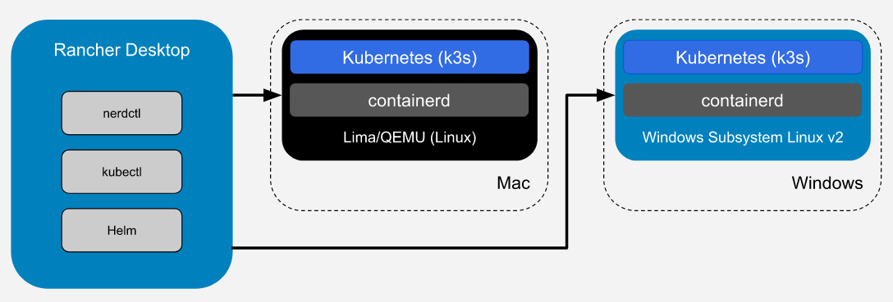
Rancher Desktop
Developer-workstation Kubernetes Engine
Rancher Desktop is an open-source desktop application for Mac and Windows. It provides Kubernetes and container management. You can choose the version of Kubernetes you want to run.
You can build, push, pull, and run container images. The container images you build can be run by Kubernetes immediately without the need for a registry.

Slide 29
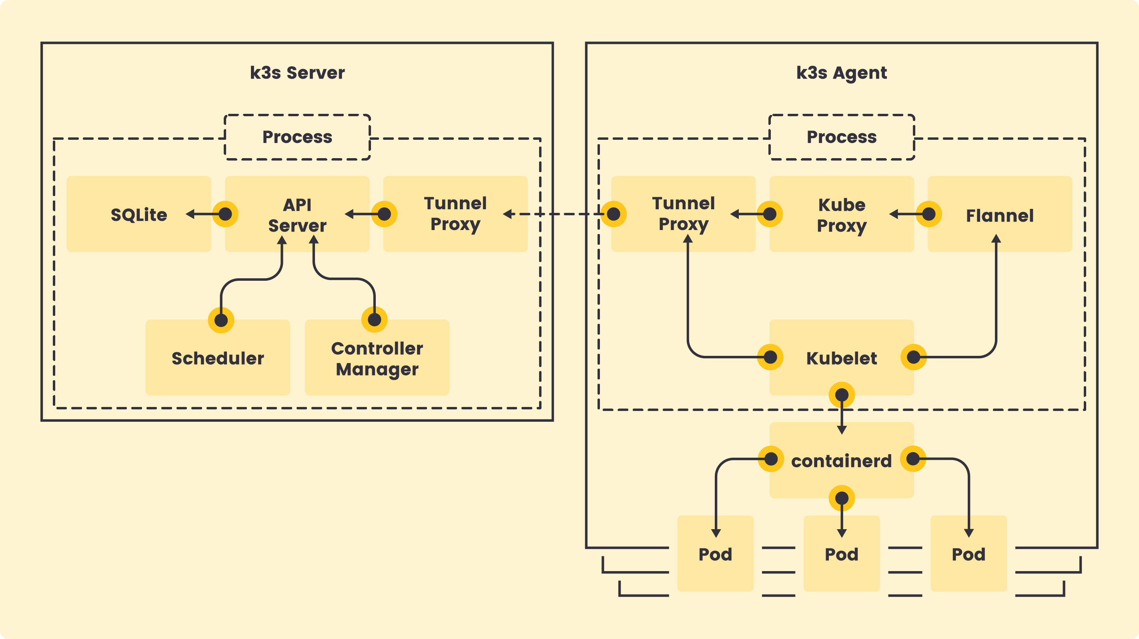
What is K3s?
Everything you need to run Kubernetes in a single binary
Embedded SQLite Database
KINE- Use SQL-based backend as an alternative to etcd. (RDS-> k3s)
Container run time (containerd)
CNI Plugin for networking (Flannel)
DNS (coredns)
Host utilities (iptables, socat, etc)
Local storage provider
Service load balance
Helm controller
Ingress controller
All components are swappable
Also available in HA
Notes:
29

Slide 30

Hauler Air-gap Migration Assistant
K3s/RKE2 as a utility / swiss-army knife for all things air-gap (Currently in dev)
NIPR/Unclass Domain
SC2s/C2s/Air-Gap
Collects & Packages commonly-used k8s binaries (helm,k9s,argocd.. etc)
Helm Container Dependency Aggregator (Charts & Images -> .tgz)
Batch collects Git repositories for migration (git clone *)
Stands up HA k3s/rke2 cluster*
Self-deploying (via ArgoCD/Fleet):
OCI-compliant Registry (images, Helm Charts, etc)
Git Server
Rancher Multi-cluster Manager
KeyCloak (iDam)
Postgres (down-range HA k3s datastore)
Pushes images/dependencies to embedded or enterprise OCI registry
Cross-domain Solution

Slide 31

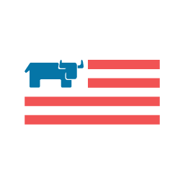


CDC Operation WARPSPEED
Rancher Federal’s engineers and technology is powering the COVID-19 Immunization Data Lake for the Centers for Disease Control and Prevention.
Rancher/CDC contract focused on a ‘Get Well Strategy’ to modernize the CDC’s immunization data lake infrastructure.
Consulting engineers introduced a hybrid-cloud architecture that migrated CDC workloads from pure AWS -> AWS, Azure, on-prem platforms.
4 Rancher federal engineers via Platform Engineering Support contract

Slide 32
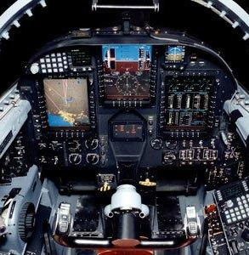
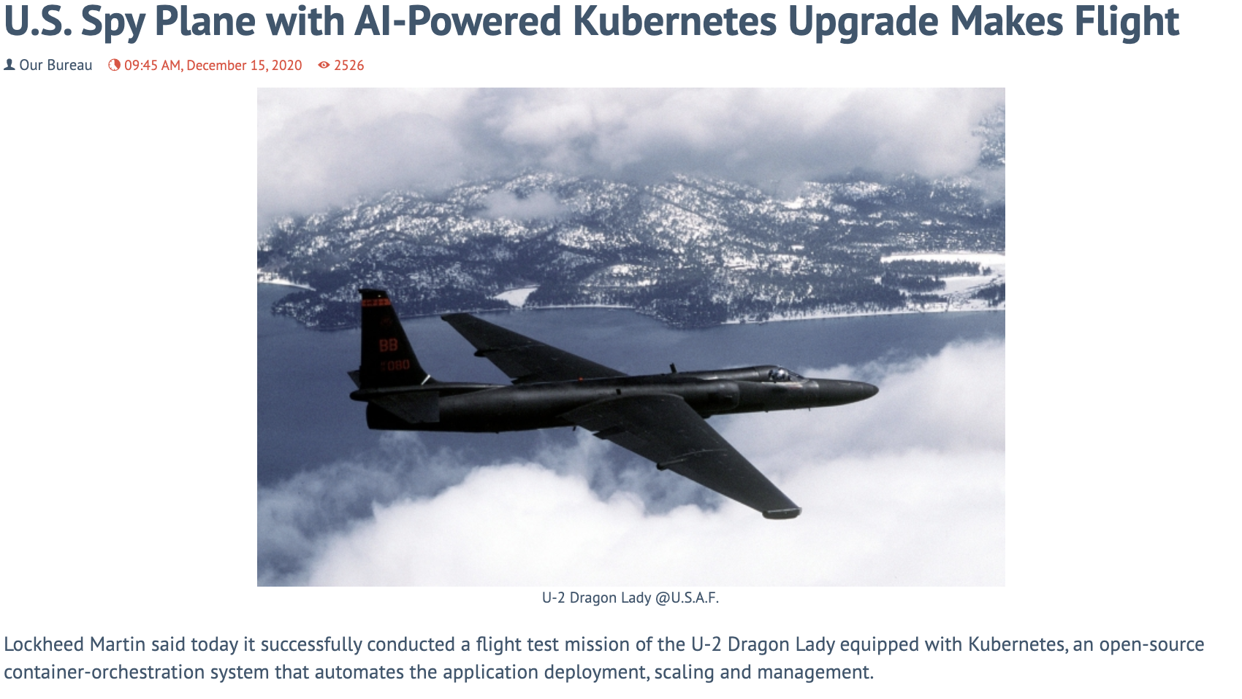
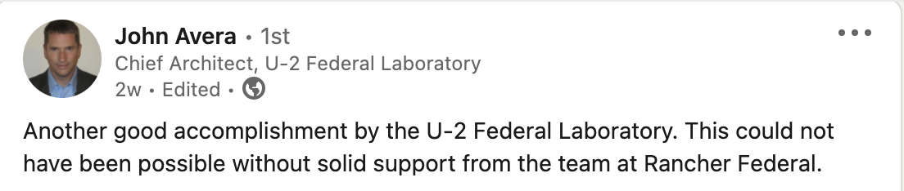
U2 Spy Plane Modernization
Rancher Federal’s engineers and technology is modernizing the in-flight cloud capabilities of the fabled flyer

Slide 33



Kubernetes is powering the next evolution of space and defence technology; Rancher is at the heart of these pioneering
deployments
Booz Allen Hamilton is connecting the modern battlefield to create the tactical edge with K3s
Hypergiant and the USAF are pioneering the use of Kubernetes in space; trialing AI and machine learning on military satellites
“When you're dealing with a link that measures in kilobits per second and is only available for a few minutes at a time during your flight or window, you have to be very efficient with what you transfer. K3s will help to achieve this efficiency."
Bren Briggs
Director of DevOps and Cybersecurity, Hypergiant
33

Slide 34


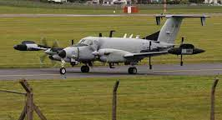
SOCOM
Analytics Team-Hybrid Environment
Why RGS-Expertise
Kubernetes/Tactical Edge
Comm Units-Deploy Containers in a constrained compute environment
Why RGS-Architectural Design, Staff
Augment, and Analytics Team Success
SOCOM HQ-Standardized on RGS for DEV/SEC/OPS
Why RGS-Demonstrated success across SOCOM in D2
DEV/SEC/OPS Environment
Notes:
Time Frame: 2 Years
GAP Team (Year 1)
Objective: Containerization across a Hybrid Environment (Data Center to Tactical Edge)
Why RGS: Expertise in Kubernetes and PaaS out to the tactical Edge
Initial Support: Initial Support package for Rancher, RKE2, K3S.
Follow on support: Acquired Professional Services to help trouble shoot specific issue in their Dev Environment.
JCU Team (Year 1.5)
Objective: Deploy Containers in low compute end tactical environments
Why RGS: GAP Team Success and Expertise in Architecting a hybrid architecture to support JCU mission.
Initial Support: Mission Acceleration Planning package (Professional Services, Engineering Services, and Support Licensing)
Follow on Support: 2 Staff Augments to provide on the ground SME’s around Rancher along with support Licensing)
SOCOM HQ (Year 2)
Objective: Standardize on Rancher as the platform for container orchestration across SOCOM Dev/Sec/Ops.
Why RGS: Based on previous success at GAP and JCU.
Support: ELA (In Process).
34

Slide 35

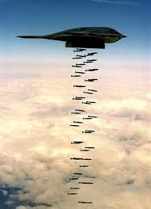
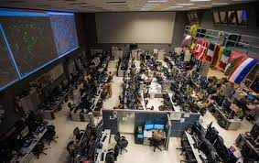


Air Force
609th AOC-Support in Hybrid Environment
Why RGS-Expertise
Kubernetes/Recommended by KR
DCGS Cloud Environment-Migrate applications to the cloud
Why RGS-Expertise in
Hybrid Multi Domain Environments
DCGS Bare Metal/On Prem Migrate applications
Why RGS-Expertise in Bare
Metal/On Prem and Previous Demonstrated Success
Notes:
AOC 609th
Objective: Migration of apps from legacy systems to cloud.
Why RGS: Expertise in Kubernetes and PaaS recommended by KR.
Initial Support: Initial Support package for Rancher, RKE2, K3S.
Follow on support (In Process): Adding Longhorn Support and exploring Harvester (HCI)
DCGS Cloud Environment (Year 1)
Objective: Move the cloud enabled weapons platform onto an Agile Development Framework in AWS.
Why RGS: Expertise in Kubernetes, PaaS and Hybrid Deployment of Containers out to the tactical edge.
Initial Support: Initial Support package for Rancher, RKE2, K3S with Professional Services
DCGS On prem and On Site (year 2)
Objective: Deploy an Agile Framework onto Bare metal and On Sites
Why RGS: Previous success of the cloud enablement piece for DCGS
Support Package (In Process): ELA with unlimited nodes, TAM, and One FTE on site along with PS hours
35

Slide 36



USAF Platform-One
2 Prime contracts with USAF Platform-One with 18 FTEs supporting the DevSecOps initiatives and platform infrastructure.
70% of P1 Kubernetes clusters are running on Rancher’s RKE2 distribution.
Rancher’s K3S distro is shipping on USAF Edge-One Satellite Mission
Direct support : ABMS, F35, INSCOM
C-ATO Approval
Rancher Government Solutions, products align with the Department of Defense DevSecOps principles and our emphasis on secure opensource solutions by default. Because Rancher’s RKE2 Kubernetes distribution is in our centralized hardened container repository Iron Bank, it allows us to take advantage of its security and ease of use, regardless of which cloud or on-premise environment we need to deploy to.”
Nicolas M. Chaillan
USAF Chief Software Officer

Slide 37
Customer Story: PlatformONE
2 Prime Contracts, Unlimited Potential
10 FTE (DSOP) 8 (SBIR) = 18 Team Members
Rancher RKE2 Kubernetes is powering:
PARTYBUS (MISSION) IL2, IL3, IL4, IL5
PARTYBUS (DSOP) IL2, IL3, IL4, IL5
USAF DNS Effort
STARGATE (cross-domain)
BIG BANG dev
IRONBANK IL5 Candidate
Rancher’s K3s is powering the EdgeOne USAF satellite launching in CY2020Q2.
BLACKPEARL (USNAVY) has chosen RKE2 as its flagship k8s platform.
Direct support: ABMS, F35, INSCOM
~70% of P1 Kubernetes clusters are running RKE2. Certificate to Field in creation.
LEADERSHIP @ P1
Josh Wolf Big Bang Lead / Chief Engineer
Adam Toy PartyBus Tech Lead
Chris Nuber EdgeONE Kubernetes Lead
* Denotes deployment with full ATO

Slide 38

Rancher Federal Support & Global Services
Support Subscriptions
Premium Services
Dedicated Senior RGS engineer point of contact (business hours) for troubleshooting & break fix support
Fast track issue escalation to senior support. "Skip-the-line" or a "fast pass" to support
Bi-Weekly virtual sync ups to ensure high level best practices and guidance
Assist with determining the customer’s technical project plan, architecture, and progression
Up to 24/7/365 break fix and troubleshooting support
Full Stack support for container runtime, Kubernetes, and Rancher Products covered by Purchased Licenses
Initial Architecture review and guidance
Consulting
Accelerate architecture and implementation
Integrated roadmaps with defined outcomes
Training Services
Kubernetes Administration
Rancher Operations
Deploy Rancher
Certifications
38
Notes:
38

Slide 39
World-Class Support
 | Support | Premium Service
Recommended Environment | Existing Team of Senior engineers | A team of engineers that may need technical guidance
Software Upgrades & Updates | Yes | Yes
Technical Support | Team of engineers | Senior Level dedicated engineer
Methods of Access | Chat, Web, Phone | Chat, Web, Phone
Hours of Access | 24x7x365 | 5x8 for TAM (Technical Account Manager) and 24x7x365 for Support
Response Time | Severity 1 – 2 Hrs Severity 2 – 4 Hrs Severity 3 – Next Business Day Severity 4 – 2 Business Days | Severity 1 – 2 Hrs Severity 2 – 4 Hrs Severity 3 – Next Business Day Severity 4 – 2 Business Days
39

Slide 40
Defining a Project Roadmap
Phases
Discover & Design
Deploy
Optimize
Objectives
Align objectives & explore solutions
Design and architect infrastructure
Full project scoping and customer approvals on project plan
Business impact validation and risk mitigation
Executive sponsorship
Implementation of project plan per agreed design
Build test/dev/staging/production platform
Integration Rancher components
Supportability review
Deliver on-demand services and support to advise, guide, and develop customer expertise
Maximize customer innovation & continual improvement
Achieve full adoption & grow usage
Ensure observability
Outcomes
Ongoing knowledge transfer, best practices, security guidance, and health checks
Cadence calls with customer success team
Training recommendations/eLearning and/or custom classes
Design, architecture and migration roadmaps
Brief detailing technology selections, decisions, recommendations, best practices, and delivery strategy to be used in later phases of project
Installation and configuration Rancher technologies
Integrations, scripts, templates, images, artifacts, and automations for new infrastructure
Supportability confirmation
Services
Pre-Sales and Pro-Serv Engineer
Program Manager Support
Training services
Consulting Services
Technical Account Manager (DSE)
Rancher Support with regular CSM check ins
40

Slide 41

Closing the Skills Gap with SUSE Training
Instructor led learning
Structured training programs directly from SUSE or SUSE Training Partners. Take public courses or customize a training path for your team. Courseware includes SLES, SLES for SAP Applications, SUSE Manager and Rancher.
Rancher Government can meet all your technical training needs. From instructor-led training courses to eLearning for immediate access and certification paths to prove skills. The choice is yours.
eLearning
24/7/365 on demand library of all SUSE technical training. Yearly subscription with courseware updated regularly.
SUSE Certification
Show your expertise with a SUSE Solutions. Start as a SUSE Certified Administrator; continue to become a SUSE Certified Engineer.
3 Day Kickstart
Instructor lead 3-day kick start training with minor customization to customers environments.
41

Slide 42

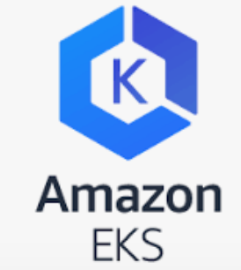
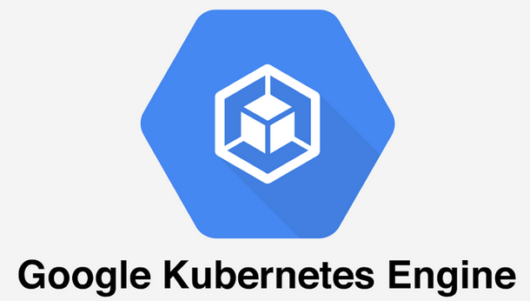
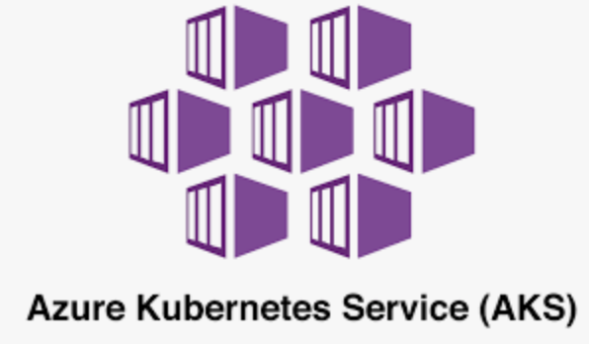
Recommended Architecture
Rancher Management Server Cluster
Rancher Management Server Cluster
All-in-one nodes
Node
Node
Node
Production Environment
Additional Environments
All-in-one nodes
Node
Node
Node
(cp/etcd/worker)
(cp/etcd/worker)
Cluster 1 - prod
Cluster 2 - prod
Cluster 1 - test
Cluster 2 - test
Control Plane
Node
Node
Control Plane
Node
Node
Control Plane
Node
Node
Control Plane
Node
Node
etcd
Node
Node
Node
etcd
Node
Node
Node
etcd
Node
Node
Node
etcd
Node
Node
Node
Worker
Node
Node
Node
Worker
Node
Node
Node
Worker
Node
Node
Node
Node
Worker
Node
Node
Node
Node
Cluster 3 - Hosted K8S - prod
Control Plane
Node
Node
Cloud Hosted
(GKE, EKS, AKS)
Environment
The Rancher Management Server cluster manages all downstream k8s. The k8s required to run Rancher are not counted in the downstream Rancher host count
etcd
Node
Node
Node
Rancher hosts are the downstream Kubernetes compute nodes managed by the Rancher Management Server cluster
Worker
Node
Node
Node
Node
Longhorn storage nodes managed by Rancher management server
No cost
42

Slide 43

Thank you!
1900 Reston Metro Plaza Suite 600 Reston, VA 20190
Phone: (844) RGS-7779
info@ranchergovernment.com
CAGE code: 8GLZ3
DUNS: 117387835

